Slide 1

Streams part 2 Stream API
details and usage outside pipeline

Slide 2
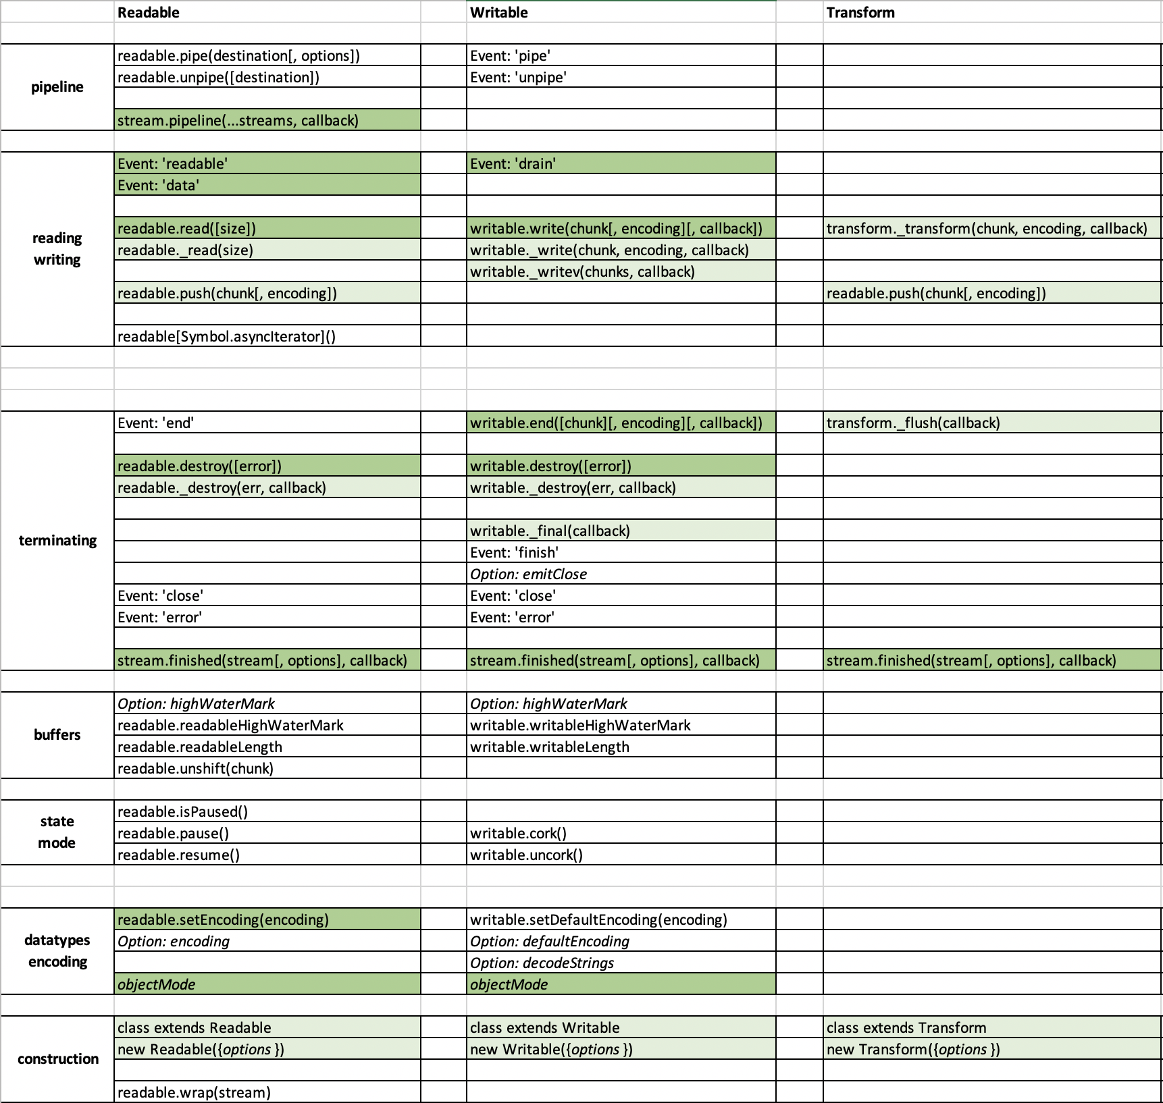
Streams API
RECAP: we have covered basic pipe, pipeline and stream implementation APIs in Part1
Today: other APIs for using streams “directly“
2019-javascript/05-prednaska/node-core-modules.xlsx

Slide 3
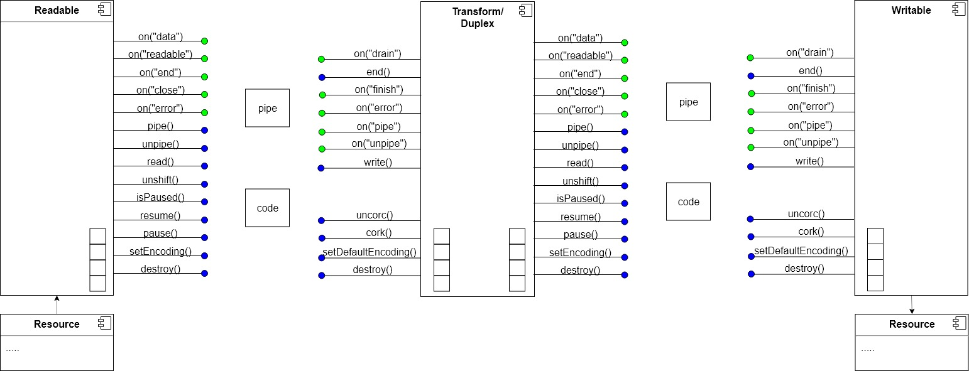
Streams API
Standard usage is to pipe
But sometimes other approaches are easier to code or just better

Slide 4
Raw Stream API vs pipeline
Two options
Pipeline – implement custom streams, pipe them
Raw API – use stream methods and events directly from code
Docs vote for pipeline often()
Use of the readable.pipe() method is recommended for most users as it has been implemented to provide the easiest way of consuming stream data.
Developers using stream.unshift() often should consider switching to use of a Transform stream instead
readable.pipe() and 'data' event mechanisms are easier to understand than the 'readable' event.
If the data to be written can be generated or fetched on demand, it is recommended to encapsulate the logic into a Readable and use stream.pipe().
…
…

Slide 5
Kedy používať pipe a kedy API
pipe
pipe
a)
stream
transform
stream
stream
api
data+end, readable+read, ...
b)
write, drain
finish,...
api
stream
c)
stream
api
read
write
api
stream
d)
pipe
pipe
e)
stream
transform
stream
ak máte na vstupe aj výstupe algoritmu streamy, kódujete pipeline a transforms
ak máte na vstupe stream a chcete vyrobiť niečo iné ako stream, kódujete pomocou API
ak nemáte na vstupe stream, ale iné data a zapisujete do streamu použijete API
ak máte na oboch koncoch streamy, nepoužívajte API, kódnuť to korektne vzhľadom na backpresure a async znamená kódnuť to isté čo pipe, pipeline()
varianta B sa dá riešiť pomocou custom writable

Slide 6
readable

Slide 7
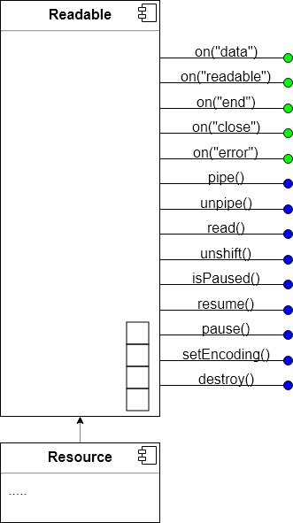
Readable - overview
Consumer
Data:
Buffer
String
Object
Modes:
Paused
Flowing
States:
readableFlowing
null
false
true
Buffer:
highWaterMark
Length
API (old/new)
pipe
on(“readable”)/read
on(“data”)
….
Concepts:
pull/push style
backpressure
error handling
Resource
Disk
Network
Memory,
…
Notes:
https://nodejs.org/en/docs/guides/backpressuring-in-streams/

Slide 8
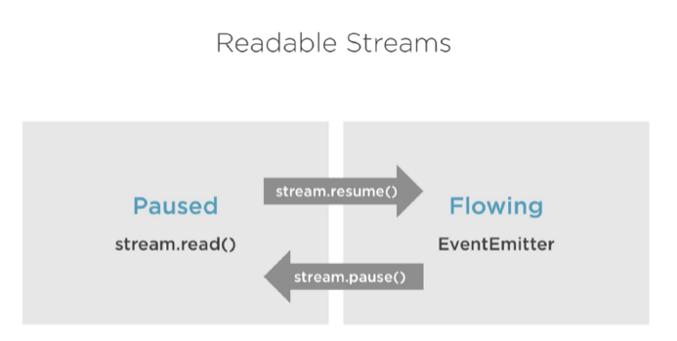
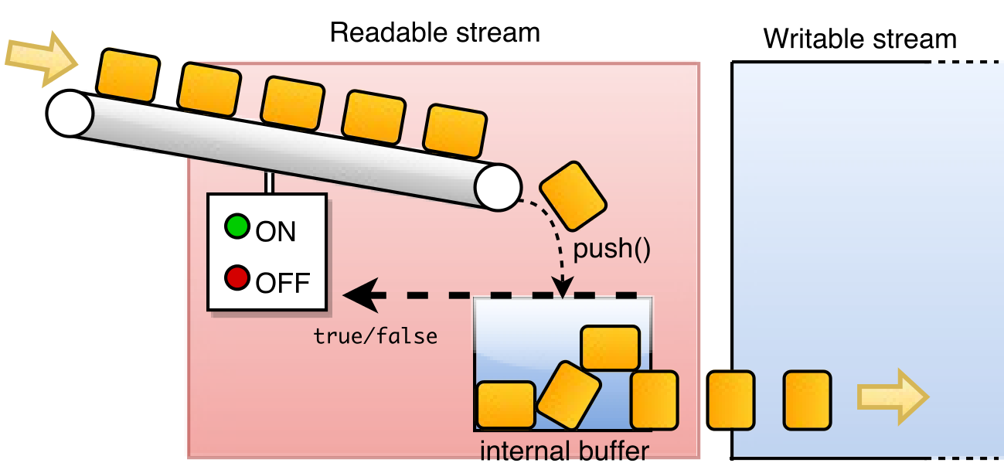
Stream Modes, States and Reading style (simplified)
Modes:
Flowing
Paused
Reading Styles:
on(“data”) - push
read() - pull
pipe() - balanced push/pusll
States (readableFlowing)
null
true
false
readable stream má dva módy:
flowing – sype vám data bez ohľadu či stíhate
paused – čaká či si data prečítate cez read alebo ho prepnete do flowing módu
podľa toho aké api použijete
pipe je prepínačka medzi flow a paused
https://nodejs.org/api/stream.html#stream_two_reading_modes

Slide 9
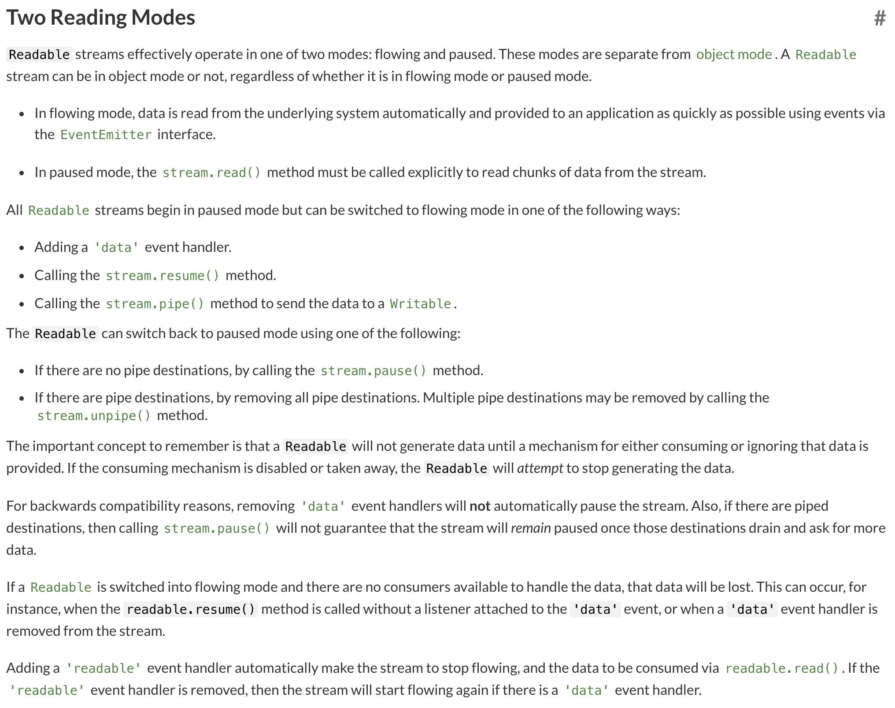
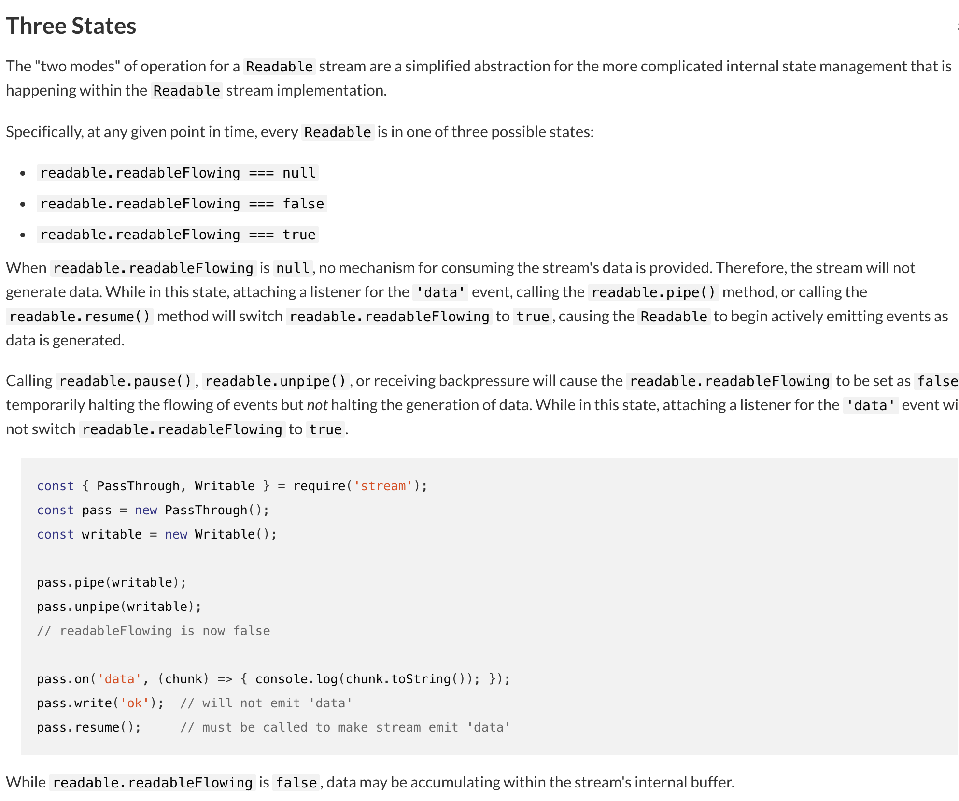
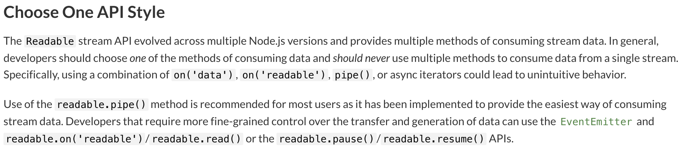
READ: https://nodejs.org/api/stream.html

Slide 10
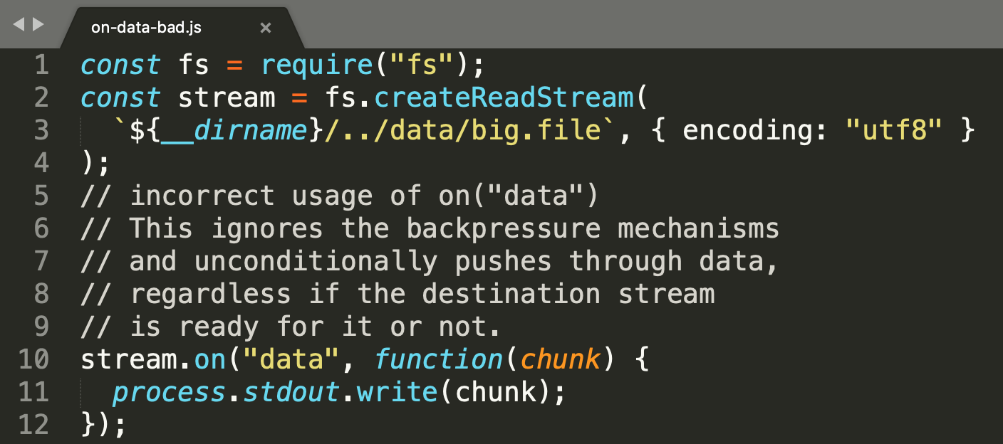
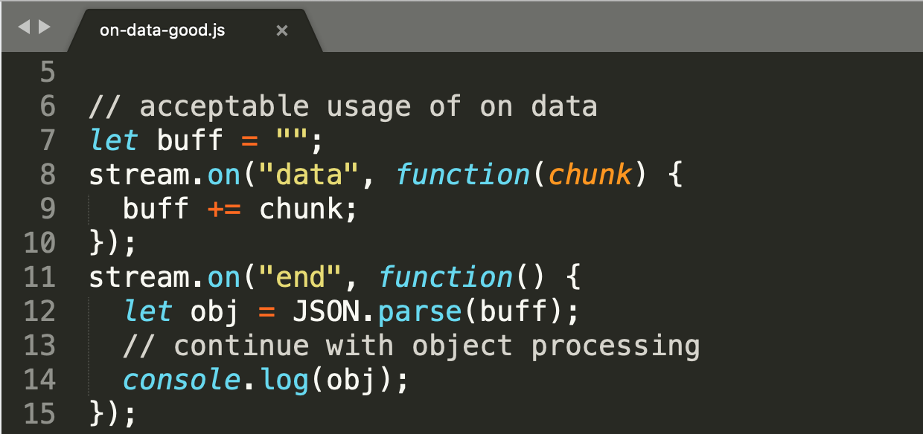
Style 1: Readable.on(“data”)
The 'data' event is emitted whenever the stream is relinquishing ownership of a chunk of data to a consumer
old/original stream api (“classic streams”)
Flowing mode,
No backpressure mechanism (will hammer you with data)
Good for final processing
bad for subsequent stream writing, Use pipe() instead for “this sort of tasks”
neviete ovládať veľkosť chunku ktorých chcete, producer o tom rozhodne
Notes:
https://nodejs.org/en/docs/guides/backpressuring-in-streams/

Slide 11
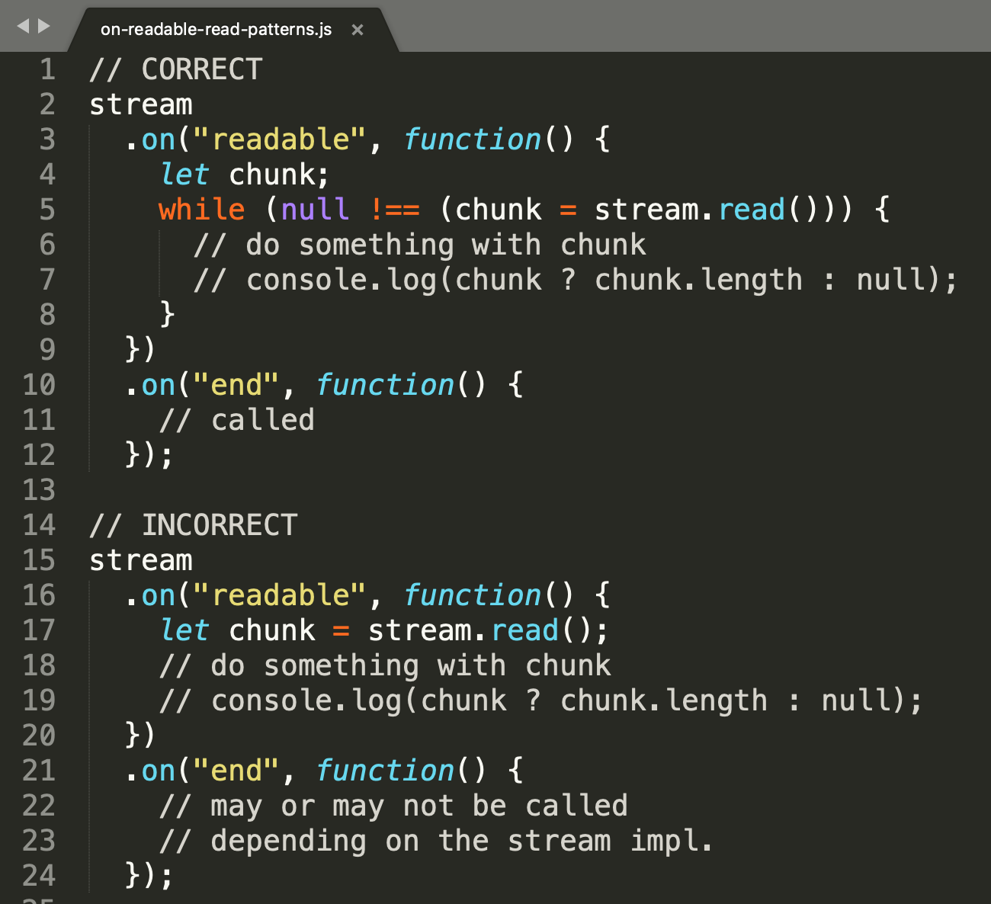
Style 2: Readable.on(“readable”) + read()
emitted every time when data available to be read from the stream
The read() method pulls some data out of the internal buffer and returns it.
no data or not enough data (size) in buffer: returns null,
when stream ends, read() returns restof data from buffer
read() calls _read only if it needs more data from resource, no extra data are generated and buffered
Pull mode, paused stream
can control, the chunk size
…
v kode on readable musite docitat cely buffer, nestaci len jeden read musi byt while
inak uz readable nikdy nemusite dostat a nedostanete ani on end kedze ste nedocitali buffer
./samples/01-readable/02-on-readable-read-patterns.js
Notes:
https://nodejs.org/en/docs/guides/backpressuring-in-streams/

Slide 12
readable end close events and finished
Keďže pracujeme zo streamami (arbitrary size or endless data), potrebujeme vedieť kedy sme už dočítali, prípadne kedy skončiť, lebo stream sa uzavrel a podobne:
A) end event
The 'end' event is emitted when there is no more data to be consumed from the stream
will not be emitted unless the data is completely consumed (read, or flowing)
Usage: finishing the job done in on(data) or on(readable) or when piping is done
B) close event:
The 'close' event is emitted when the stream and any of its underlying resources (a file descriptor, for example) have been closed. The event indicates that no more events will be emitted, and no further computation will occur.
C) finished(stream) method:
A function to get notified when a stream is no longer readable, writable or has experienced an error or a premature close event. Especially useful in error handling scenarios where a stream is destroyed prematurely (like an aborted HTTP request), and will not emit 'end' or 'finish'.
Notes:
https://nodejs.org/en/docs/guides/backpressuring-in-streams/

Slide 13
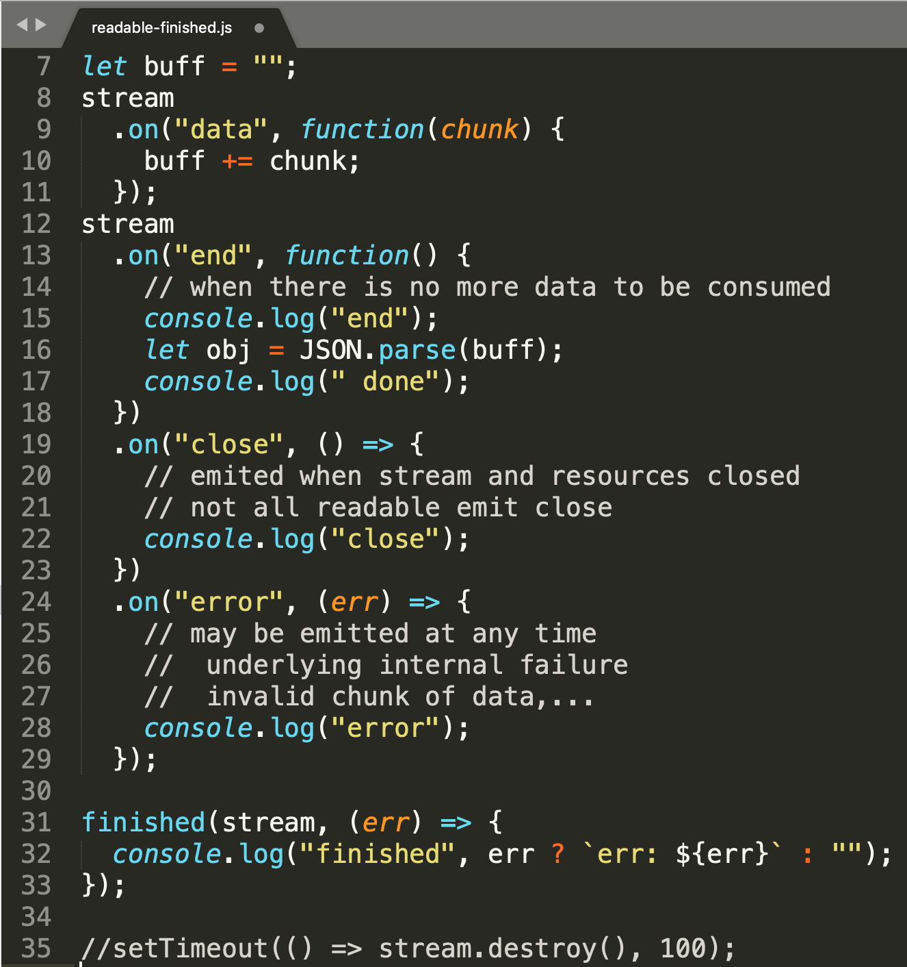
readable end close events and finished
za bežných okolností sa udeje:
data,data,...
end
done
finished
close
ak ale niekto (klient, server) zavrie nečakane stream [35] , nastane poradie eventov:
data,data,...
close
finished err Premature close
Ak by ste nemali zaregistrovaný finished handler (< 10.0.0):
data,data,...
close
end, ani error nenastane, takže v close by ste museli ifovať na nejaké svoje variables, aby ste sa dozvedeli, či end nastal alebo nie, a keďže nie každý stream podporuje close, nemáte sa to ako dozvedieť.
Ponaučenie: používať finished.
Notes:
https://nodejs.org/en/docs/guides/backpressuring-in-streams/

Slide 14
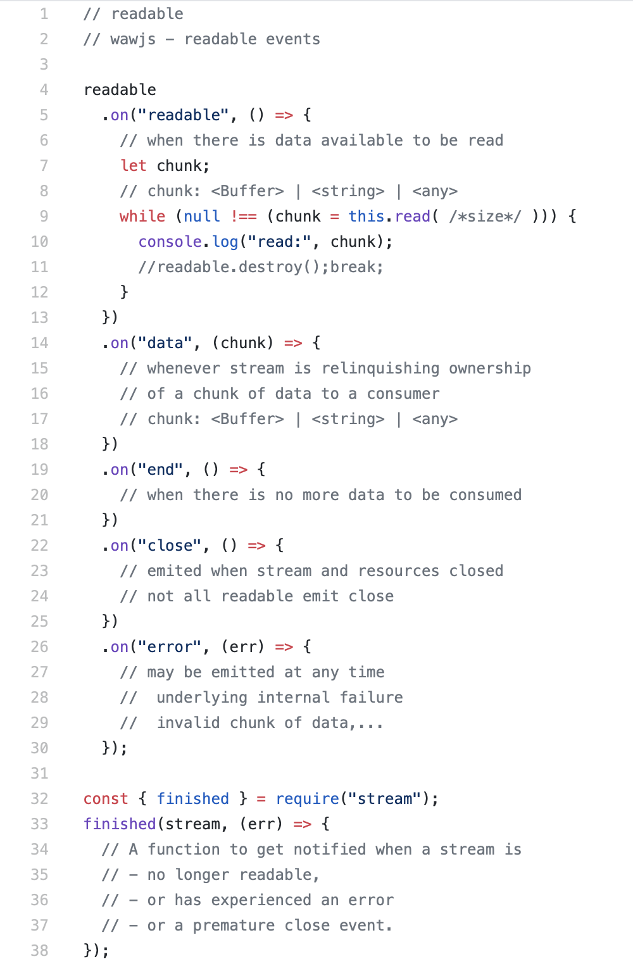
RECAP: Readable events
2 data events
pull/paused
push/flowing
3 terminal events
1 simplified terminal callback
ready as snippet: https://github.com/ainthek/wawjs-snippets/blob/master/src/readable.events.js

Slide 15
readable.destroy([error])
Destroys the stream, and emit 'error' and 'close‘ (end not emitted)
After this call, the readable stream will release any internal resources
kedy chcete volať destroy()
v pipeline kódoch asi nikdy
pri manuálnych kódoch, ak ste už prečítali dosť a nepotrebujete viac, dát

Slide 16
readable.read([size])
Reading arbitrary size from stream
The optional size argument specifies a specific number of bytes to read.
If size bytes are not available to be read,
null will be returned
unless the stream has ended, in which case all of the data remaining in the internal buffer will be returned.
If the size argument is not specified, all of the data contained in the internal buffer will be returned.

Slide 17
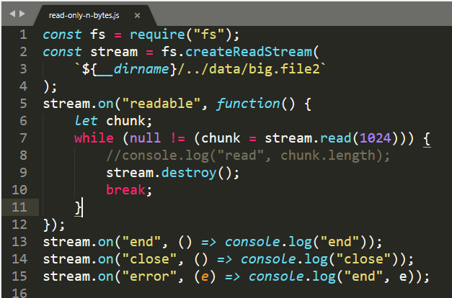
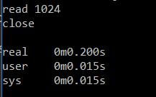
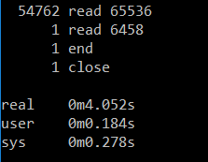
readable.destroy() + read(size)
reading stream partially
metadata/headers parsing, find first match ….
read only n bytes
read all
see: https://github.com/ainthek/wawjs-snippets/blob/master/src/readable-read-size.js

Slide 18

Samples
BEWARE: INTERNET

Slide 19
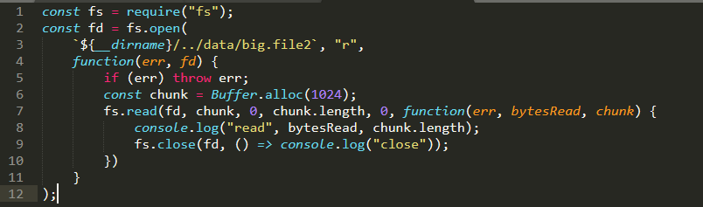
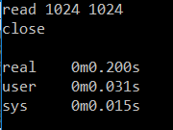
userland examples: partial read read(size) and fs, and fd
If working with filesystem, there is less generic solution:
See: fs.read(fd, buffer, offset, length, position, callback)
See: https://www.npmjs.com/package/read-chunk
Not much nicer, not much faster (on win at least)
fs.read()
readable.read()

Slide 20
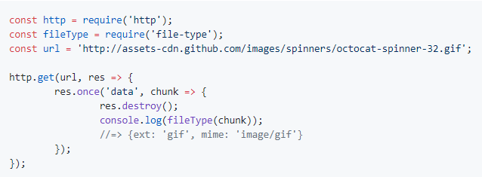

userland examples: partial read readable.destroy()
Another (bad) example of partial reading:
https://github.com/sindresorhus/file-type
Čo je zlé na tom sampli ?
Spolieha sa na to, že dostal chunk dostatočnej veľkosti
To je ďalší rozdiel medzi on data a readable/read

Slide 21
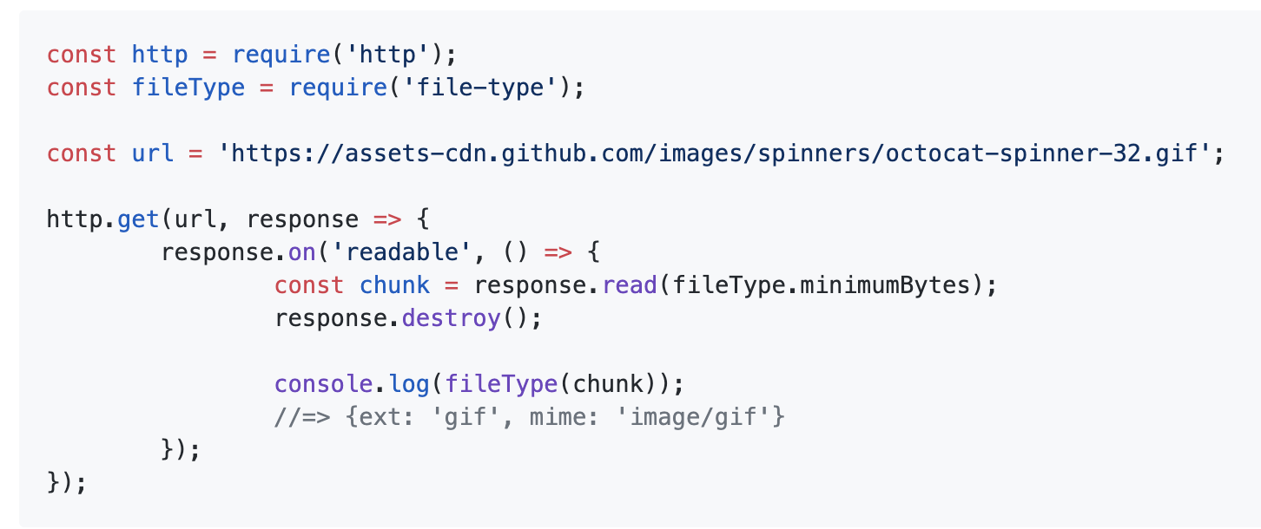
userland examples: partial read readable.destroy()
Another (bad) example of partial reading:
https://github.com/sindresorhus/file-type
Čo je zlé na tom sampli ? Ozaj to autor fixol ?
Spolieha sa na to, že dostal chunk dostatočnej veľkosti
Čo ak readable nemá v buffri minimumBytes ?

Slide 22
writable

Slide 23
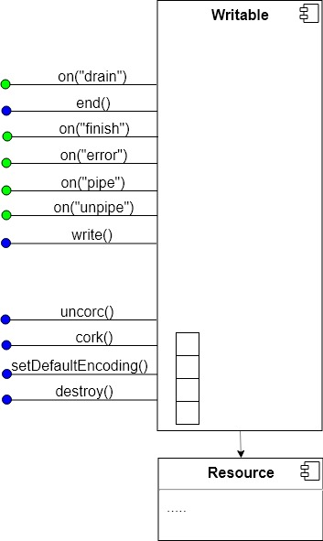
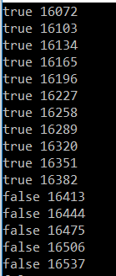
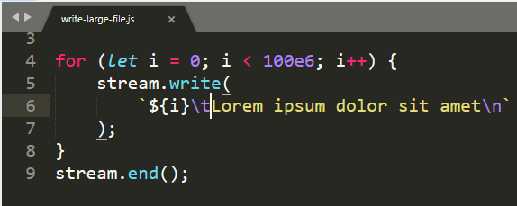
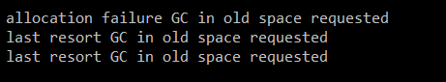
writable.write()
The writable.write() method writes some data to the stream, and calls the supplied callback once the data has been fully handled.

Slide 24
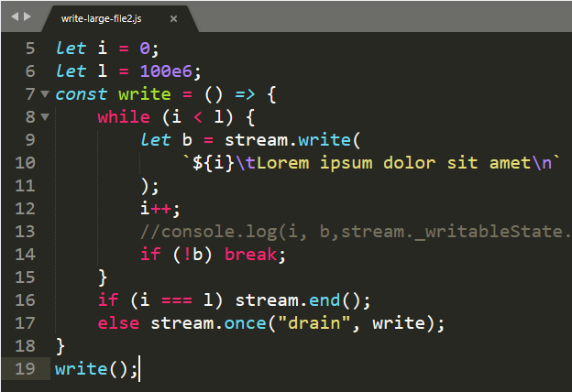
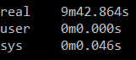
writable.write()->bool,on(“drain”)
If a call to stream.write(chunk) returns false, the 'drain' event will be emitted when it is appropriate to resume writing data to the stream
Other sample: https://nodejs.org/api/stream.html#stream_event_drain

Slide 25
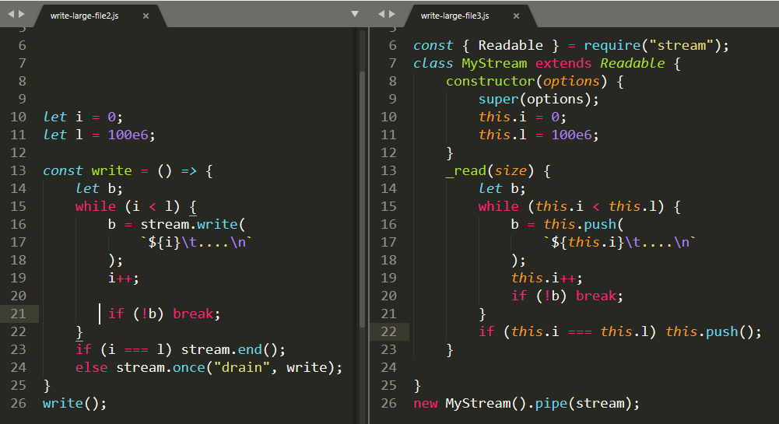
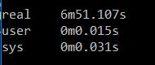
writable.write() , but pipe()
If the data to be written can be generated or fetched on demand, it is recommended to encapsulate the logic into a Readable and use stream.pipe().

Slide 26
writable.on(“finish”);
The 'finish' event is emitted after the stream.end() method has been called, and all data has been flushed to the underlying system
“Zda sa” ze on(“finish”) sa zavola len ak kazdy _write zavolal callback (podobne ako z readable.on(“end”)
…
…
…

Slide 27
Encodings
Buffer, string,........ object streams

Slide 28
Readable encoding
By default, no encoding is assigned and stream data will be returned as Buffer objects.
Setting an encoding causes the stream data to be returned as strings of the specified encoding rather than as Buffer objects.
Ozaj ? Platí pre:
on data event
read()
a _transform v móde decodeStrings : false
The Readable stream will properly handle multi-byte characters delivered through the stream that would otherwise become improperly decoded if simply pulled from the stream as Buffer objects.
The readable.setEncoding() method sets the character encoding for data read from the Readable stream.
Notes:
https://nodejs.org/en/docs/guides/backpressuring-in-streams/

Slide 29
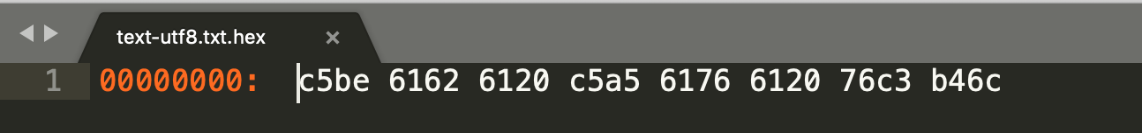

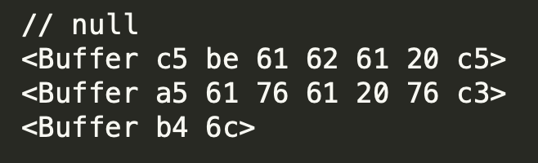
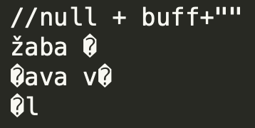
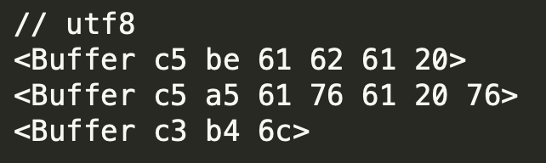
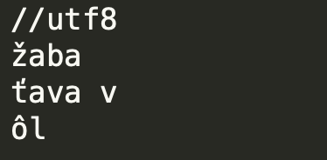
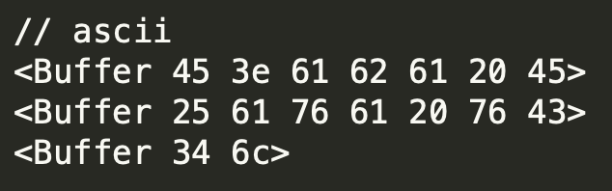
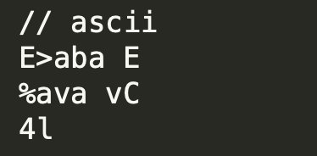
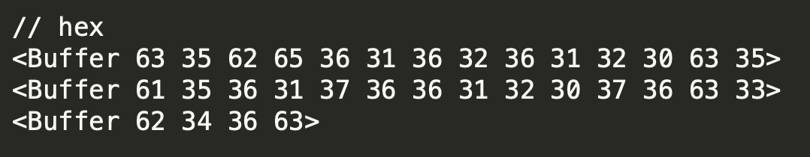
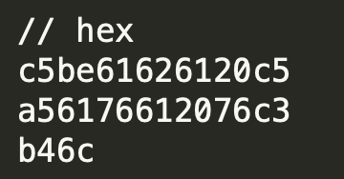
Readable encoding
čo vlastne robí readable encoding ? The readable.setEncoding() method sets the character encoding for data read from the Readable stream
majme stream / file z takýmto byte obsahom (utf8 enkódnuté nasledovné dta)
podľa toho aký encoding setneme na readable dostaneme do write streamu takýto buffer
.pipe(new Writable({write(chunk)}));
+ decodeStrings=true
on(„data“, chunk)
chunk=read()
const stream = fs.createReadStream(fileUtf8, "utf8")

Slide 30
Supported Encodings
utf8 - Multibyte encoded Unicode characters. Many web pages and other document formats use UTF-8.
ascii - For 7-bit ASCII data only. This encoding is fast and will strip the high bit if set.
utf16le - 2 or 4 bytes, little-endian encoded Unicode characters. Surrogate pairs (U+10000 to U+10FFFF) are supported.
latin1 - A way of encoding the Buffer into a one-byte encoded string (as defined by the IANA in RFC1345, page 63, to be the Latin-1 supplement block and C0/C1 control codes).
hex - Encode each byte as two hexadecimal characters.
base64 - Base64 encoding. When creating a Buffer from a string, this encoding will also correctly accept "URL and Filename Safe Alphabet" as specified in RFC4648, Section 5.
ucs2 - Alias of 'utf16le'.
binary - Alias for 'latin1'.
https://nodejs.org/api/buffer.html#buffer_buffers_and_character_encodings

Slide 31
properly handle multi-byte chars
Máte text z diakritkou
Procesujete ho pomocou on(data) alebo read() alebo transform
Pracujete z bufframi (chunk je buffer)
Na dev-e vsecko chodi
V produkcii je rozsypana diakritika
Preco ?
V produkcii vam vysla velkost bufra presne do stredu multibyte znaku, doma ste mali stastie Konverzia vyrobila z toho zly znak
Zle testy: male data, vsecky sa vojdu do jedneho buffra, alebo ste sa proste netrafili
Nedocitane doksy (prvy sample z stack overflow)

Slide 32
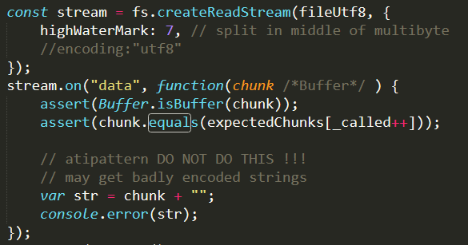
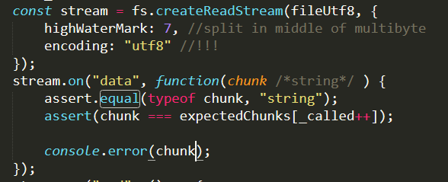
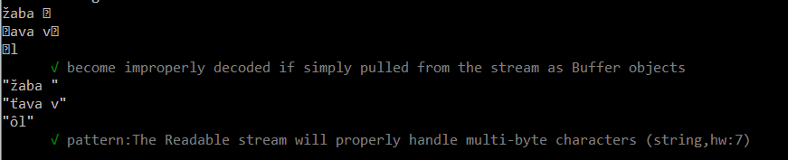
properly handle multi-byte chars
https://nodejs.org/api/stream.html#stream_readable_setencoding_encoding
DOCS Readable.encoding: The Readable stream will properly handle multi-byte characters delivered through the stream that would otherwise become improperly decoded if simply pulled from the stream as Buffer objects.
HINT: specify encoding and let buffer to do multibyte logic, work with strings

Slide 33
userland encoding packages
https://www.npmjs.com/package/windows-1250
https://www.npmjs.com/package/iconv
You must accumulate the small buffers into a single large buffer before performing the conversion. If you don't, you will get unexpected results with multi-byte and stateful character sets like UTF-8 and ISO-2022-JP.
To neni dobre, netreba vsecko !, da sa aj lepsie https://nodejs.org/api/string_decoder.html
But how to plug them to node.js and streams the best way ?

Slide 34
Play (exploratory tests) with encoding
Encoding Tests
encoding
✓ on('data') returns Buffer, without encoding specified (fileUtf8)
✓ on('data') returns Buffer, without encoding specified, (fileWin1250)
✓ on('data') returns string, with options.encoding specified
✓ read() returns Buffer, without encoding specified
✓ read() returns string, with options.encoding specified
✓ _write() receives Buffer (not string), with Readable(encoding specified),
✓ _write() receives string, needs Readable(options.encoding) + writable.decodeStrings=false,
✓ if Readable(options) is a string, then it specifies the encoding
✓ if options is a string, and INVALID encoding is specified, it FAILS
✓ if options.encoding, and INVALID encoding is specified, it FAILS
✓ node DOES NOT SUPPORT windows1250 encoding
✓ reading windows1250 with latin1 will not produce expected result
✓ piping windows1250 file to Iconv stream seems to work
✓ piping windows1250 file to custom Transform() works as well
✓ Antipatern: Strings become improperly decoded if simply pulled from the stream as Buffer objects
✓ Antipatern: Strings *can get* properly decoded by toString() in _transform
✓ nonsence: Can we detect encoding from source when piped ? (instead use decodeString:false and work with strings)
✓ Pattern: The Readable stream will properly handle multi-byte characters (string,hw:7)
see: ./prednasky/07-streams/samples/encoding/encoding.spec.js

Slide 35
Evolution of modules
Stream, Streams2, Stream3
through2,readable-stream
https://r.va.gg/2014/06/why-i-dont-use-nodes-core-stream-module.html
https://github.com/nodejs/readable-stream

Slide 36
npm
Homework: Collection of modules to review:
https://github.com/maxogden/mississippi
https://www.npmjs.com/package/read-chunk
https://github.com/sindresorhus/strip-bom-stream (a jeho suciastky)
https://github.com/wayfind/is-utf8#readme (probably as BAD sample ;-))
https://www.npmjs.com/package/readtoend
https://github.com/maxogden/mississippi
https://www.npmjs.com/package/concat-stream

Slide 37
Buffer
core module, global data structire in node.js

Slide 38
Buffer
Prior to the introduction of TypedArray, the JavaScript language had no mechanism for reading or manipulating streams of binary data.
The Buffer class was introduced as part of the Node.js API to enable interaction with octet streams in TCP streams, file system operations, and other contexts.
With TypedArray now available, the Buffer class implements the Uint8Array API in a manner that is more optimized and suitable for Node.js.
https://nodejs.org/api/buffer.htm

Slide 39
Buffer
Instances of the Buffer class are similar to arrays of integers but correspond to
fixed-sized,
raw memory allocations outside the V8 heap.
The size of the Buffer is established when it is created and cannot be changed.
Specialities of Buffer:
Initialized(filled) vs. uninitialized
Prealocated (pooled/reused, fresh)
Shared memory
https://nodejs.org/api/buffer.htm

Slide 40
Buffer overview
Buffer.from
allocated outside V8 heap
String
encoding
buffer
> 8k / 2
buffer
fixed length
Array
97
buffer
of <integer>
bytes
0xc5
0xBE
APIs
Buffer
Uint8Array
Object
Buffer API
buffer.buffer
ArrayBuffer
ArrayBuffer
same memory
alloc*()
initialized
0
pool
alloc
0
un-initialized
?
buffer
< 8k / 2
buffer

Slide 41
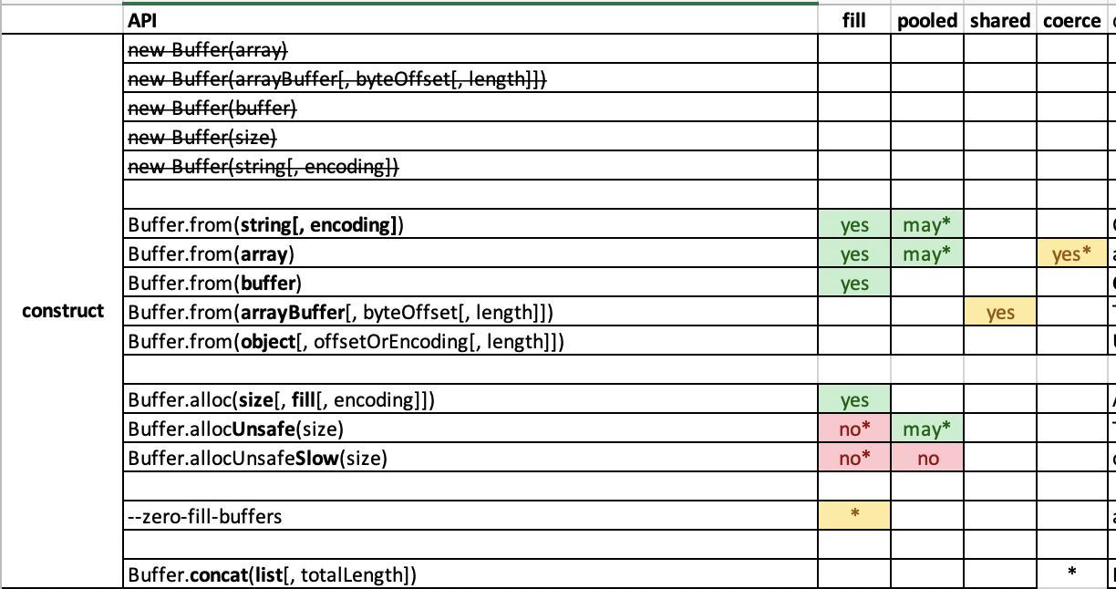
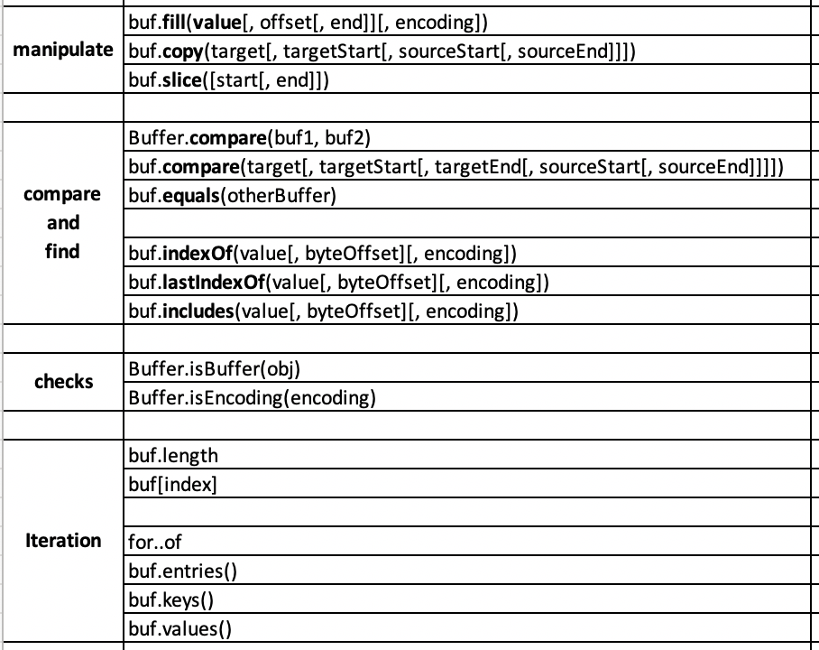
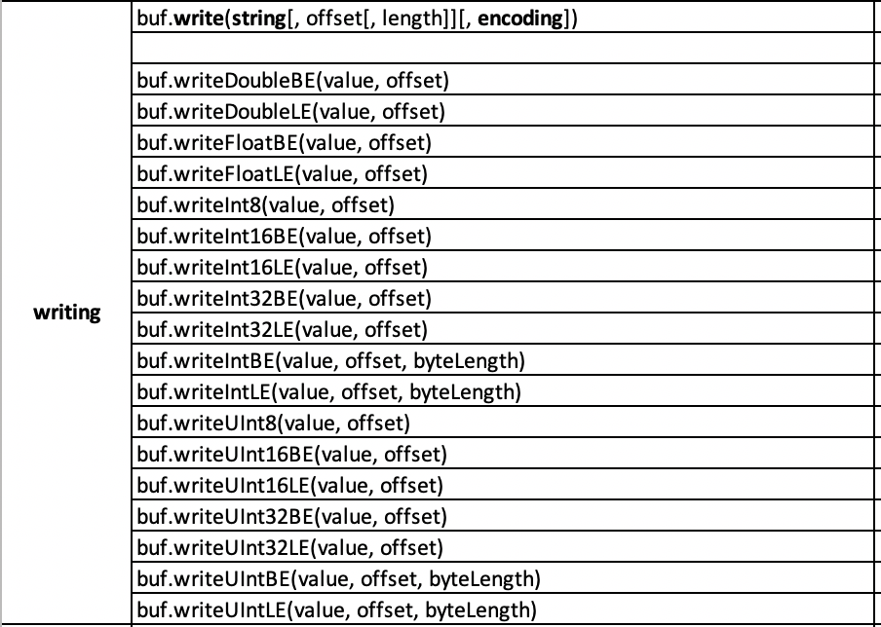
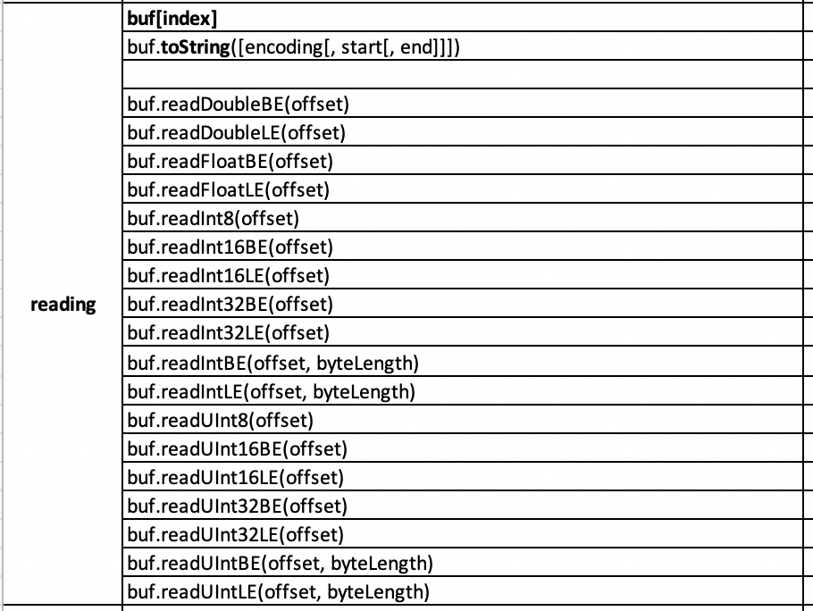
Buffer API overview (not complete)
pozri: https://nodejs.org/api/buffer.html; a 01-platformy-technologie-a-node-js/node-modules-and-api.xlsx

Slide 42
Buffer API introduction
pozri: bom-transform-and-buffer-walk.pptx
samoštúdium

